Slide 1
Purchase Card (PCard) Data Warehousing and Reporting
Presented By:
Tejasvini Shelar
Vineetha Alluri

Slide 2
Index
Objective
Data Streaming
Data Loading
Data Modelling
Generating Reports
Future Work

Slide 3
Objective
Create a data warehouse for credit card data and perform analytics to give us business insights.
Learn cleaning, streaming, storing and reporting using tools like StreamSets, HDFS, Hive, Impala and Tableau.
Generate reports for credit card agency, vendors, card holders and transactions using Tableau.

Slide 4
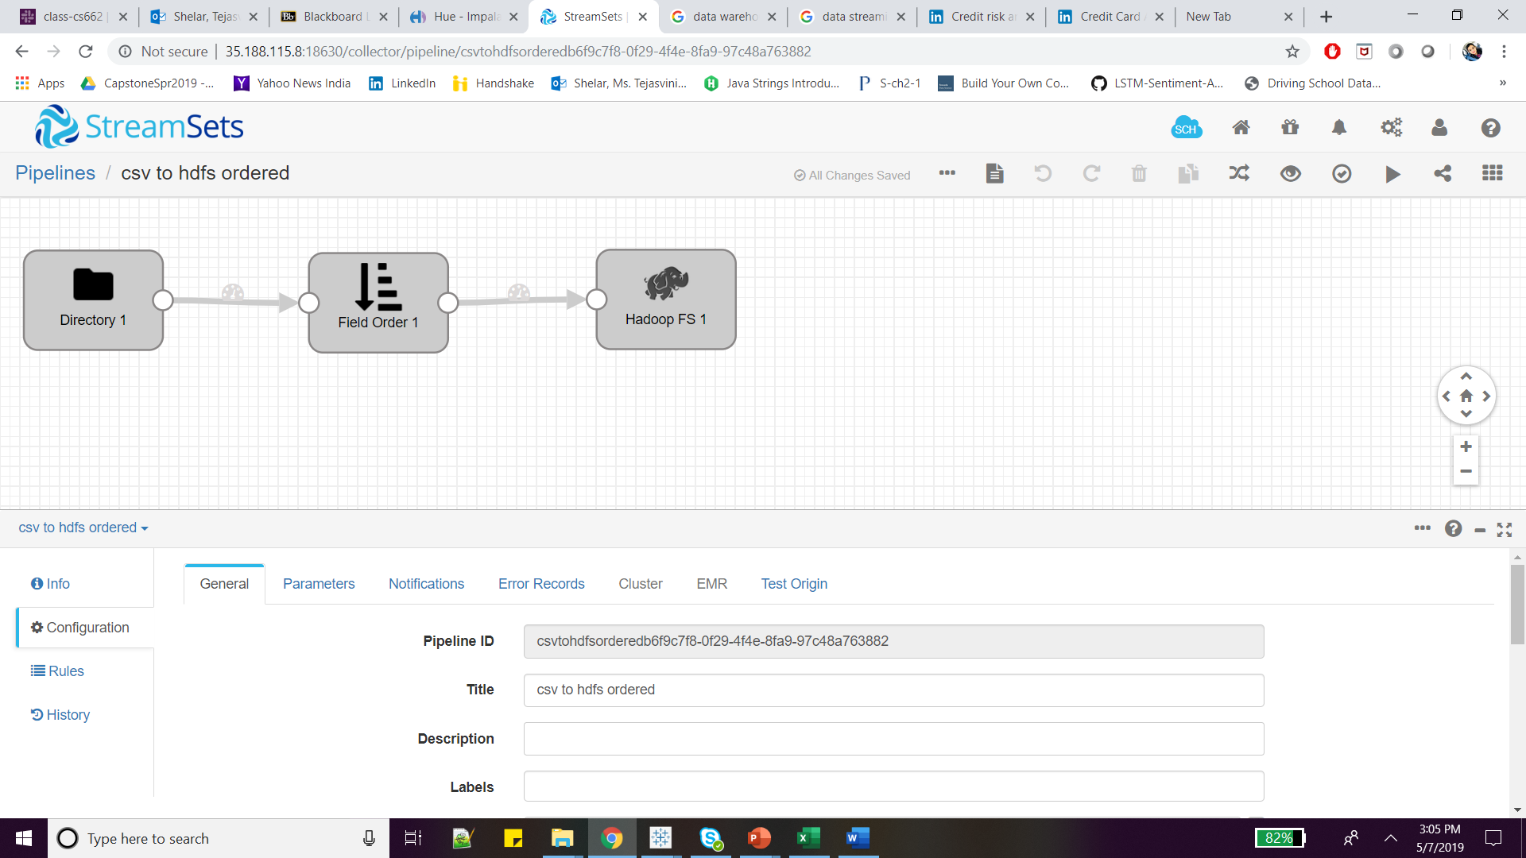
Data Streaming
Streaming data is data that is continuously generated.
First, used WinSCP for loading data from local system to Hadoop local directory.
Then ingested from directory to HDFS using StreamSets dataflow pipeline.

Slide 5
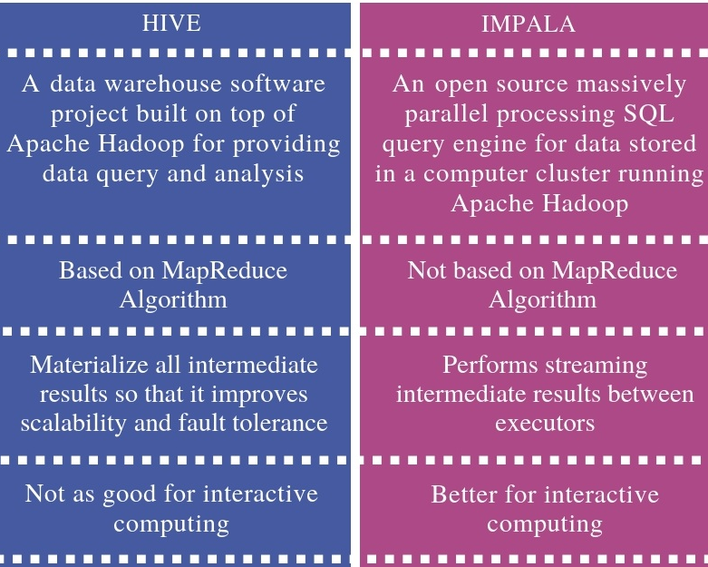
Data Loading
Load distributed data from
HDFS to stage table in Hive or Impala
Performed two types of data loading
HDFS to Hive
HDFS to Impala

Slide 6
Generating Reports

Slide 7
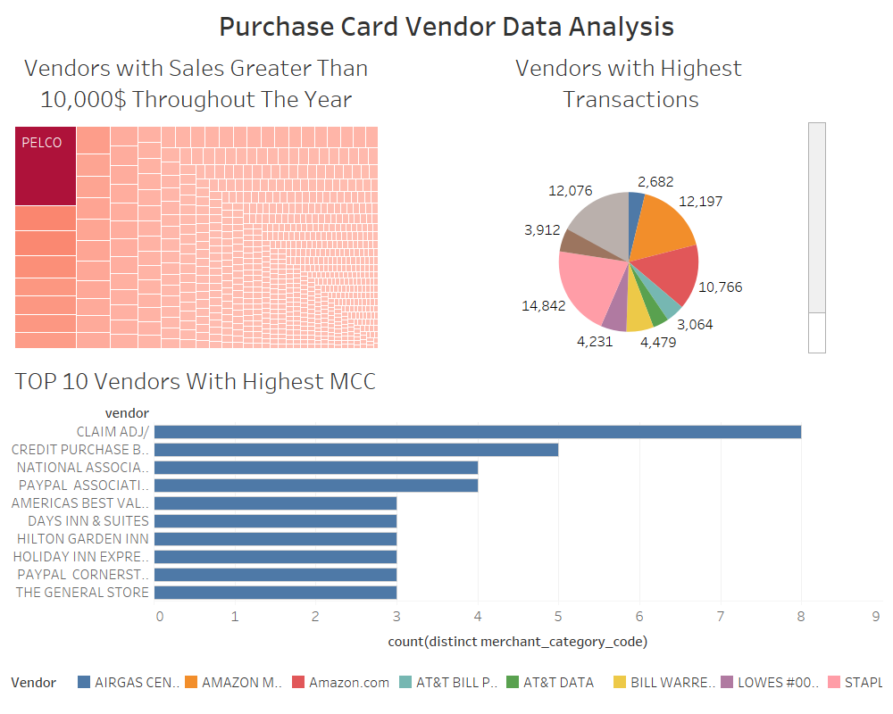

Slide 8
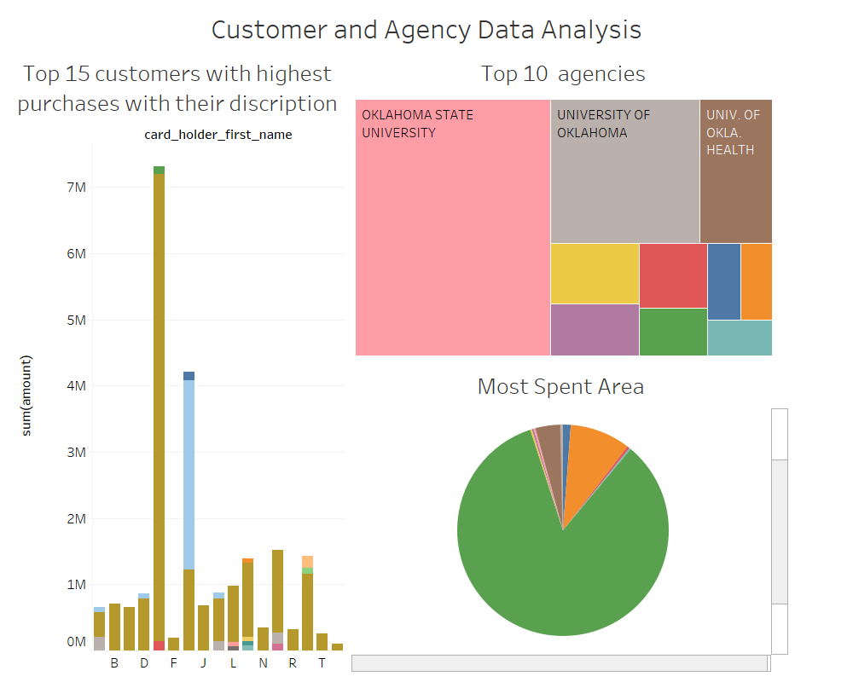

Slide 9
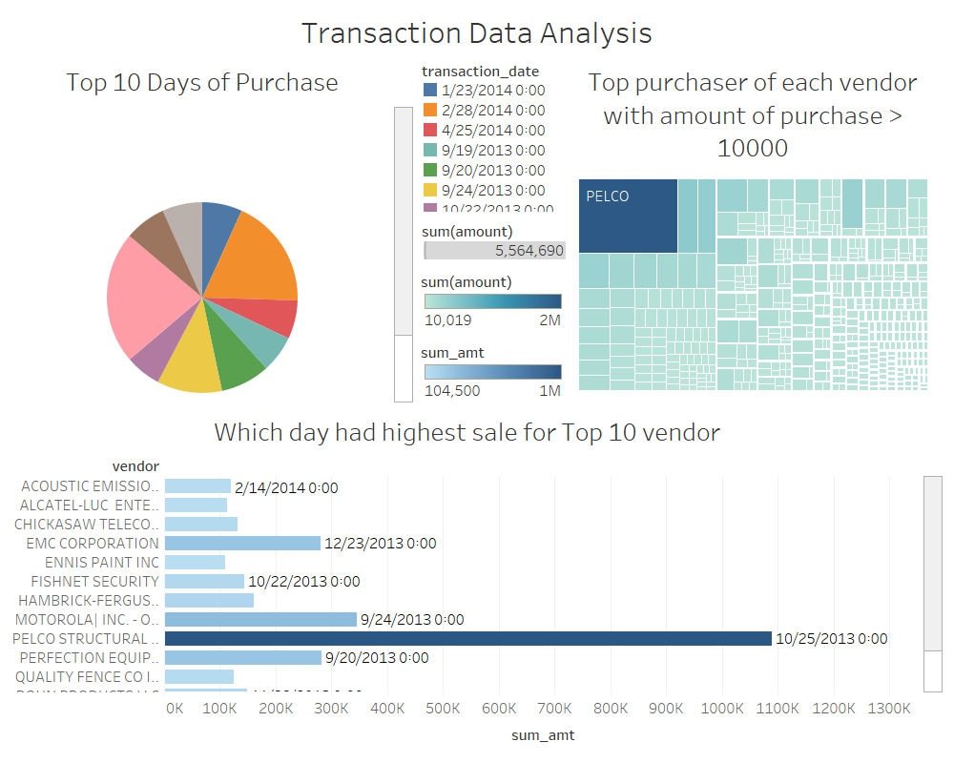

Slide 10
Future Work
Build normalized data model for data warehouse.
For loading data every month use Oozie job scheduling.

Slide 11
Data Modelling
Dimension Table
Facts Table
Card_Provider
agency_Number
agency_name
Card_Holder
First_name
Last_name
Product_Vendor_Merchant
description
Vendor
merchatCC
Transaction
Amount
Transaction_date
posted_date

